Slide 1


Principles of Information Security,
Fifth Edition
Chapter 4
Planning for Security

Slide 2
Learning Objectives
Upon completion of this material, you should be able to:
  Describe management’s role in the development, maintenance, and enforcement of information security policy, standards, practices, procedures, and guidelines
  Explain what an information security blueprint is, identify its major components, and explain how it supports the information security program
Principles of Information Security, Fifth Edition
Notes:
Learning Objectives
Upon completion of this material, you should be able to:
Describe management’s role in the development, maintenance, and enforcement of information security policy, standards, practices, procedures, and guidelines
Explain what an information security blueprint is, identify its major components, and explain how it supports the information security program

Slide 3
Learning Objectives (cont’d)
  Discuss how an organization institutionalizes its policies, standards, and practices using education, training, and awareness programs
  Describe what contingency planning is and how it relates to incident response planning, disaster recovery planning, and business continuity plans
Principles of Information Security, Fifth Edition
Notes:
Learning Objectives
Discuss how an organization institutionalizes its policies, standards, and practices using education, training, and awareness programs
Describe what contingency planning is and how it relates to incident response planning, disaster recovery planning, and business continuity plans

Slide 4
Introduction
Information security program begins with policies, standards, and practices, which are the foundation for information security architecture and blueprint.
Coordinated planning is required to create and maintain these elements.
Strategic planning for the management of allocation of resources
Contingency planning for the preparation of uncertain business environment
Principles of Information Security, Fifth Edition
Notes:
Introduction
Information security program begins with policies, standards, and practices, which are the foundation for information security architecture and blueprint
Coordinated planning required to create and maintain these elements
Strategic planning for management of allocation of resources
Contingency planning for preparation of uncertain business environment

Slide 5
Information Security Planning and Governance
Planning levels help translate organization’s strategic plans into tactical objectives.
Planning and the CISO
Information Security Governance
  Governance:
    Set of responsibilities and practices exercised by the board and executive management
    Goal to provide strategic direction, establishment of objectives, and measurement of progress toward objectives
    Also verifies/validates that risk management practices are appropriate and assets used properly
Principles of Information Security, Fifth Edition
Notes:
InfoSec Planning and Governance
Planning levels help translate organization’s strategic plans into tactical objectives
Planning and the CISO
Information Security Governance
Governance:
Set of responsibilities and practices exercised by the board and executive management
Goal to provide strategic direction, establishment of objectives, and measurement of progress toward objectives
Also verifies/validates that risk management practices are appropriate and assets used properly

Slide 6
Information Security Planning and Governance (cont’d)
Information Security Governance outcomes
  Five goals:
    Strategic alignment
    Risk management
    Resource management
    Performance measures
    Value delivery
Principles of Information Security, Fifth Edition
Notes:
InfoSec Planning and Governance
Information Security Governance outcomes
Five goals
Strategic alignment
Risk management
Resource management
Performance measures
Value delivery

Slide 7
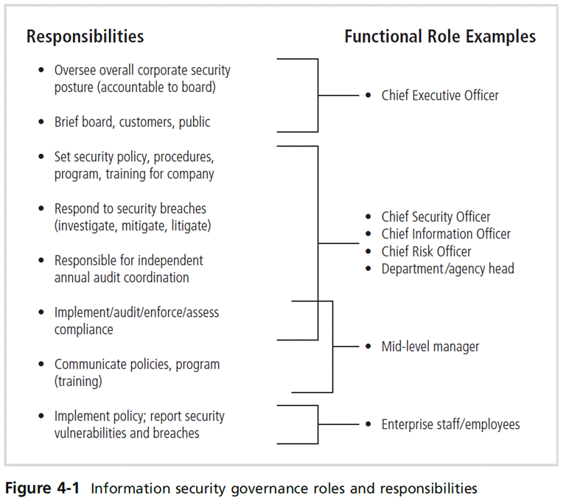
Principles of Information Security, Fifth Edition

Slide 8
Information Security Policy, Standards, and Practices
Management from communities of interest must make policies the basis for all information security planning, design, and deployment.
Policies direct how issues should be addressed and technologies used.
Policies should never contradict law, must be able to stand up in court, and must be properly administered.
Security policies are the least expensive controls to execute but most difficult to implement properly.
Principles of Information Security, Fifth Edition
Notes:
Information Security Policy, Standards, and Practices
Management from communities of interest must make policies the basis for all information security planning, design, and deployment
Policies direct how issues should be addressed and technologies used
Policies should never contradict law, must be able to stand up in court, must be properly administered
Security policies are the least expensive controls to execute but most difficult to implement properly

Slide 9
Policy as the Foundation for Planning
Policy functions as organizational law that dictates acceptable and unacceptable behavior.
Standards: more detailed statements of what must be done to comply with policy
Practices, procedures, and guidelines effectively explain how to comply with policy.
For a policy to be effective, it must be properly disseminated, read, understood, and agreed to by all members of the organization, and uniformly enforced.
Principles of Information Security, Fifth Edition
Notes:
Policy as Foundation for Planning
Policy functions as organizational law that dictates acceptable and unacceptable behavior
Standards: more detailed statements of what must be done to comply with policy
Practices, procedures, and guidelines effectively explain how to comply with policy
For a policy to be effective, it must be properly disseminated, read, understood, and agreed to by all members of organization, and uniformly enforced

Slide 10
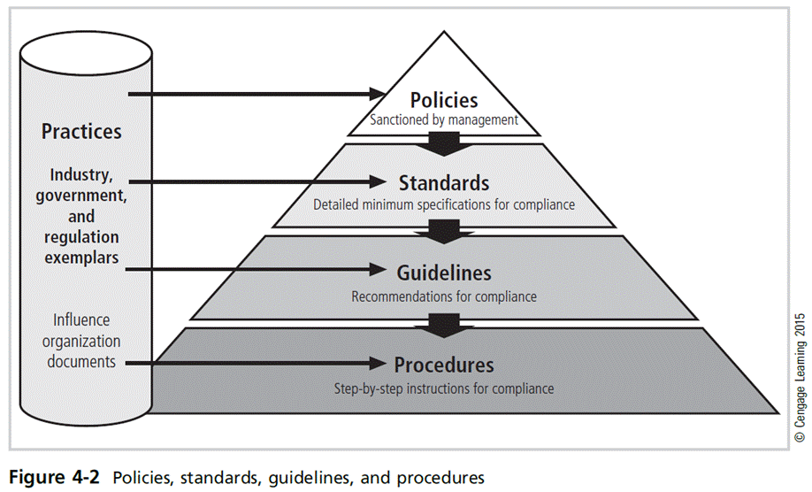
Principles of Information Security, Fifth Edition
Notes:
Types of Policy
Management defines three types of security policy:
1) General or security program policy
2) Issue-specific security policies
3) Systems-specific security policies

Slide 11
Enterprise Information Security Policy (EISP)
Sets strategic direction, scope, and tone for all security efforts within the organization
Executive-level document, usually drafted by or with Chief Information Officer (CIO) of the organization
Typically addresses compliance in two areas:
  Ensure meeting of requirements to establish program and assigning responsibilities therein to various organizational components
  Use of specified penalties and disciplinary action
Principles of Information Security, Fifth Edition
Notes:
Enterprise Information Security Policy (EISP)
Sets strategic direction, scope, and tone for all security efforts within the organization
Executive-level document, usually drafted by or with Chief Information Officer (CIO) of the organization
Typically addresses compliance in two areas
Ensure meeting of requirements to establish program and assigning responsibilities therein to various organizational components
Use of specified penalties and disciplinary action

Slide 12
Enterprise Information Security Policy (EISP) (cont’d)
EISP Elements should include:
  Overview of corporate security philosophy
  Information on the structure of the organization and people in information security roles
  Articulated responsibilities for security shared by all members of the organization
  Articulated responsibilities for security unique to each role in the organization
Principles of Information Security, Fifth Edition
Notes:
Enterprise Information Security Policy (EISP)
EISP Elements should include
Overview of corporate security philosophy
Information on structure of organization and people in information security roles
Articulated responsibilities for security shared by all members of organization
Articulated responsibilities for security unique to each role in organization

Slide 13
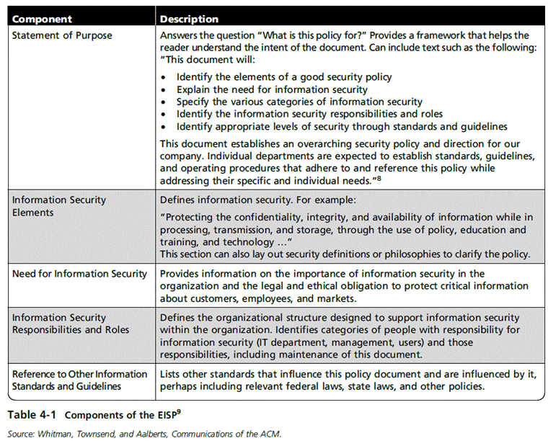
Principles of Information Security, Fifth Edition

Slide 14
Issue-Specific Security Policy (ISSP)
The ISSP:
  Addresses specific areas of technology
  Requires frequent updates
  Contains statement on the organization’s position on
  specific issue
Three common approaches when creating and managing ISSPs:
  Create a number of independent ISSP documents
  Create a single comprehensive ISSP document
  Create a modular ISSP document
Principles of Information Security, Fifth Edition
Notes:
Issue-Specific Security Policy (ISSP)
The ISSP:
Addresses specific areas of technology
Requires frequent updates
Contains statement on organization’s position on
specific issue
Three common approaches when creating and managing ISSPs:
Create a number of independent ISSP documents
Create a single comprehensive ISSP document
Create a modular ISSP document

Slide 15
Issue-Specific Security Policy (ISSP) (cont’d)
Components of the policy:
  Statement of policy
  Authorized access and usage of equipment
  Prohibited use of equipment
  Systems management
  Violations of policy
  Policy review and modification
  Limitations of liability
Principles of Information Security, Fifth Edition
Notes:
ISSP cont’d.
Components of the policy
Statement of Policy
Authorized Access and Usage of Equipment
Prohibited Use of Equipment
Systems Management
Violations of Policy
Policy Review and Modification
Limitations of Liability

Slide 16
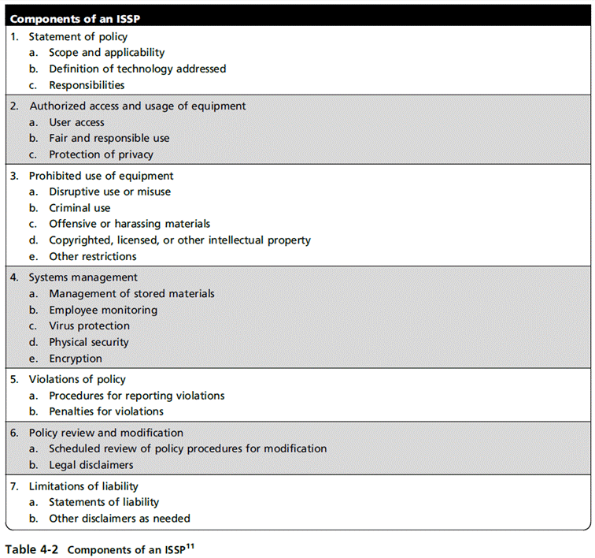
Principles of Information Security, Fifth Edition

Slide 17
Systems-Specific Policy (SysSP)
SysSPs often function as standards or procedures used when configuring or maintaining systems.
Systems-specific policies fall into two groups:
  Managerial guidance
  Technical specifications
Access control lists (ACLs) can restrict access for a particular user, computer, time, duration—even a particular file.
Configuration rule policies govern how security system reacts to received data.
Combination SysSPs combine managerial guidance and technical specifications.
Principles of Information Security, Fifth Edition
Notes:
Systems-Specific Policy (SysSP)
SysSPs often function as standards or procedures used when configuring or maintaining systems
Systems-specific policies fall into two groups
Managerial guidance
Technical specifications
Access control lists (ACLs) can restrict access for a particular user, computer, time, duration—even a particular file
Configuration rule policies govern how security system reacts to received data
Combination SysSPs combine managerial guidance and technical specifications

Slide 18
Policy Management
Policies must be managed as they constantly change.
To remain viable, security policies must have:
  A responsible manager
  A schedule of reviews
  A method for making recommendations for reviews
  A policy issuance and revision date
  Automated policy management
Principles of Information Security, Fifth Edition
Notes:
Policy Management
Policies must be managed as they constantly change
To remain viable, security policies must have:
Responsible manager
A schedule of reviews
Method for making recommendations for reviews
Policy issuance and revision date
Automated policy management

Slide 19
The Information Security Blueprint
Basis for design, selection, and implementation of all security policies, education and training programs, and technological controls
Detailed version of security framework (outline of overall information security strategy for organization)
Specifies tasks and order in which they are to be accomplished
Should also serve as a scalable, upgradeable, and comprehensive plan for the current and future information security needs
Principles of Information Security, Fifth Edition
Notes:
Information Security Blueprints
Basis for design, selection, and implementation of all security policies, education and training programs, and technological controls
Detailed version of security framework (outline of overall information security strategy for organization)
Specifies tasks and order in which they are to be accomplished
Should also serve as scalable, upgradeable, and comprehensive plan for current and future information security needs

Slide 20
The ISO 27000 Series
One of the most widely referenced security models
Standard framework for information security that states organizational security policy is needed to provide management direction and support
Purpose is to give recommendations for information security management
Provides a starting point for developing organizational security
Principles of Information Security, Fifth Edition
Notes:
ISO 17799/BS 7799
One of the most widely referenced security models
Standard framework for information security that states organizational security policy is needed to provide management direction and support
Purpose is to give recommendations for information security management
Provides a starting point for developing organizational security

Slide 21
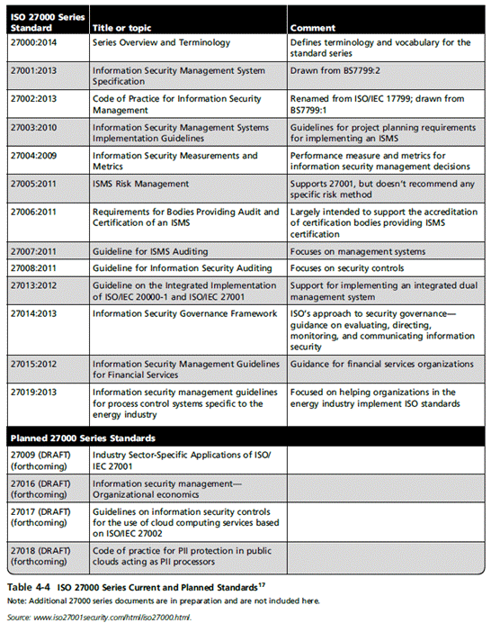
Principles of Information Security, Fifth Edition

Slide 22
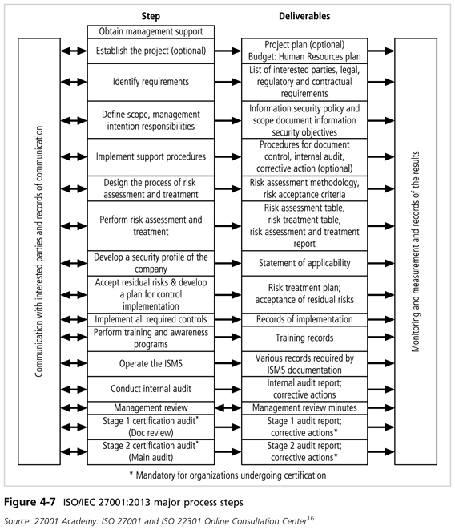
Principles of Information Security, Fifth Edition

Slide 23
NIST Security Models
Another possible approach described in the documents available from Computer Security Resource Center of NIST
  SP 800-12
  SP 800-14
  SP 800-18 Rev. 1
  SP 800-26
  SP 800-30
Principles of Information Security, Fifth Edition
Notes:
NIST Security Models
Another approach available is described in the many documents available from the Computer Security Resource Center of the National Institute for Standards and Technology (csrc.nist.gov).
These are among the references cited by the government of the U.S. when deciding not to select the ISO/IEC 17799 standards.
NIST SP 800-12 - The Computer Security Handbook is an excellent reference and guide for the security manager or administrator in the routine management of information security.
NIST SP 800-14 - Generally Accepted Principles and Practices for Securing IT Systems provides best practices and security principles that can direct the development of a security blueprint.
NIST SP 800-18 - The Guide for Developing Security Plans for IT Systems is considered the foundation for a comprehensive security blueprint and framework. It provides detailed methods for assessing, designing, and implementing controls and plans for various sized applications.

Slide 24
NIST Special Publication 800-14
Security supports the mission of the organization and is an integral element of sound management.
Security should be cost effective; owners have security responsibilities outside their own organizations.
Security responsibilities and accountability should be made explicit; security requires a comprehensive and integrated approach.
Security should be periodically reassessed; security is constrained by societal factors.
Thirty-three principles for securing systems (see Table 4-5)
Principles of Information Security, Fifth Edition
Notes:
NIST SP 800-14 Generally Accepted Principles and Practices
Security supports mission of organization; is an integral element of sound management
Security should be cost effective; owners have security responsibilities outside their own organizations
Security responsibilities and accountability should be made explicit; security requires a comprehensive and integrated approach
Security should be periodically reassessed; security is constrained by societal factors
33 principles for securing systems (see Table 4-5)

Slide 25
NIST Cybersecurity Framework
Consists of three fundamental components:
  Framework core: set of information security activities an organization is expected to perform and their desired results
  Framework tiers: help relate the maturity of security programs and implement corresponding measures and functions
  Framework profile: used to perform a gap analysis between the current and a desired state of information security/risk management
Principles of Information Security, Fifth Edition
Notes:
NIST Cybersecurity Framework
Consists of three fundamental components
Framework core: set of information security activities organization is expected to perform and desired results
Framework tiers: help relate maturity of security programs and implement corresponding measures and functions
Framework profile: used to perform gap analysis between current and desired state of information security/risk management

Slide 26
NIST Cybersecurity Framework (cont’d)
Seven-step approach to implementing/improving programs:
  Prioritize and scope
  Orient
  Create current profile
  Conduct risk assessment
  Create target profile
  Determine, analyze, prioritize gaps
  Implement action plan
Principles of Information Security, Fifth Edition
Notes:
NIST Cybersecurity Framework
Seven-step approach to implementing/improving programs:
Prioritize and scope
Orient
Create current profile
Conduct risk assessment
Create target profile
Determine, analyze, prioritize gaps
Implement action plan

Slide 27
Other Sources of Security Frameworks
Federal Agency Security Practices (FASP)
Computer Emergency Response Team Coordination Center (CERT/CC)
International Association of Professional Security Consultants
Principles of Information Security, Fifth Edition
Notes:
Other Sources of Security Frameworks
Federal Agency Security Practices (FASP)
Computer Emergency Response Team Coordination Center (CERT/CC)
International Association of Professional Security Consultants

Slide 28
Design of Security Architecture
Spheres of security: foundation of the security framework
Levels of controls:
  Management controls set the direction and scope of the security processes and provide detailed instructions for its conduct.
  Operational controls address personnel and physical security, and the protection of production inputs/outputs.
  Technical controls are the tactical and technical implementations related to designing and integrating security in the organization.
Principles of Information Security, Fifth Edition
Notes:
Design of Security Architecture
Spheres of security: foundation of the security framework
Levels of controls
Management controls set direction and scope of security processes, provide detailed instructions for its conduct
Operational controls address personnel and physical security, and protection of production inputs/outputs
Technical controls are tactical and technical implementations related to designing and integrating security in organization

Slide 29
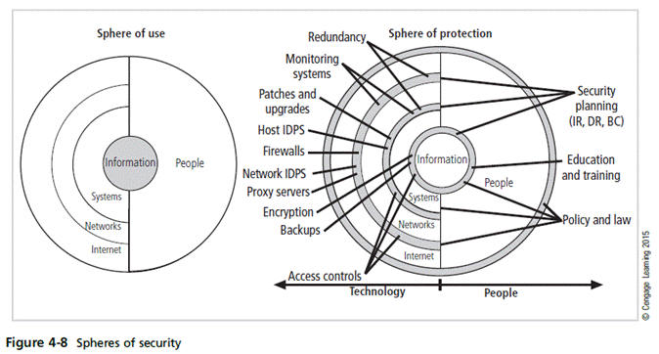
Principles of Information Security, Fifth Edition
Notes:
Figure 6-16, showing the sphere of security, is the foundation of the security framework.
Generally speaking, the sphere of security represents the fact that information is under attack from a variety of sources. The sphere of use, at the left of the figure, illustrates the ways in which people can directly access information; for example, people read hard copies of documents; they also access information through systems, such as the electronic storage of information.
Information, as the most important asset to security, is illustrated at the core of the sphere. Information is always at risk from attacks through the people and computer systems that have direct access to the information. Networks and the Internet represent indirect threats, as exemplified by the fact that a person attempting to access information from the Internet must first go through the local networks and then access systems that contain the information. The sphere of protection, at the right of the figure, illustrates that between each layer of the sphere of use there must exist a layer of protection to prevent access to the inner layer from the outer layer. Each shaded band is a layer of protection and control. For example, the layer labeled “policy education and training” is located between people and the information.
Controls are also implemented between systems and the information, between networks and the computer systems, and between the Internet and internal networks. This reinforces the concept of defense in depth.
As illustrated in the sphere of protection portion of Figure 6-16, a variety of controls can be used to protect the information. The list in the figure is not intended to be comprehensive but illustrates individual safeguards that protect the various systems that are located closer to the center of the sphere. However, as people can directly access each ring as well as the information at the core of the model, people require unique approaches to security.
In fact, the resource of people must become a layer of security, a human firewall that protects the information from unauthorized access and use. The members of the organization must become a safeguard, which is effectively trained, implemented, and maintained, or else they, too, become a threat to the information.

Slide 30
Design of Security Architecture (cont’d)
Defense in depth
  Implementation of security in layers
  Requires that organization establish multiple layers of security controls and safeguards
Security perimeter
  Border of security protecting internal systems from outside threats
  Does not protect against internal attacks from employee threats or onsite physical threats
Principles of Information Security, Fifth Edition
Notes:
The Design of Security Architecture
Defense in Depth – One of the foundations of security architectures is the requirement to implement security in layers. Defense in depth requires that the organization establish sufficient security controls and safeguards, so that an intruder faces multiple layers of controls.
Security Perimeter – The point at which an organization’s security protection ends and the outside world begins is referred to as the security perimeter. Unfortunately, the perimeter does not apply to internal attacks from employee threats or on-site physical threats.

Slide 31
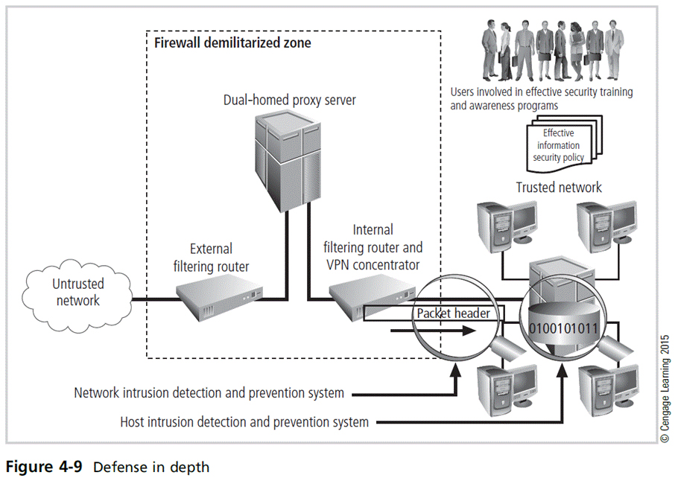
Principles of Information Security, Fifth Edition

Slide 32
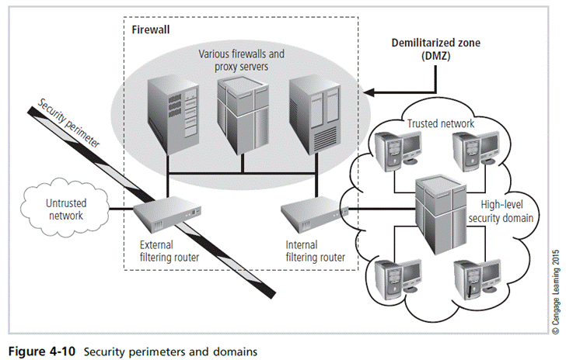
Principles of Information Security, Fifth Edition

Slide 33
Security Education, Training, and Awareness Program
Once general security policy exists, implement security education, training, and awareness (SETA) program
SETA is a control measure designed to reduce accidental security breaches.
The SETA program consists of security education, security training, and security awareness.
Enhances security by improving awareness, developing skills, and knowledge, and building in-depth knowledge
Principles of Information Security, Fifth Edition
Notes:
Security Education, Training, and Awareness Program
Once general security policy exists, implement security education, training, and awareness (SETA) program
SETA is a control measure designed to reduce accidental security breaches
The SETA program consists of: security education; security training; and security awareness
Enhances security by improving awareness, developing skills and knowledge, and building in-depth knowledge

Slide 34
Security Education
Everyone in an organization needs to be trained and aware of information security; not every member needs a formal degree or certificate in information security.
When formal education is deemed appropriate, an employee can investigate courses in continuing education from local institutions of higher learning.
A number of universities have formal coursework in information security.
Principles of Information Security, Fifth Edition
Notes:
Security Education
Everyone in an organization needs to be trained and aware of information security; not every member needs formal degree or certificate in information security
When formal education is deemed appropriate, an employee can investigate courses in continuing education from local institutions of higher learning
A number of universities have formal coursework in information security

Slide 35
Security Training
Provides members of the organization with detailed information and hands-on instruction to prepare them to perform their duties securely
Management of information security can develop customized in-house training or outsource the training program.
Alternatives to formal training include conferences and programs offered through professional organizations.
Principles of Information Security, Fifth Edition
Notes:
Security Training
Provides members of organization with detailed information and hands-on instruction to prepare them to perform their duties securely
Management of information security can develop customized in-house training or outsource the training program
Alternatives to formal training include conferences and programs offered through professional organizations

Slide 36
Security Awareness
One of the least frequently implemented but most beneficial programs is the security awareness program.
Designed to keep information security at the forefront of users’ minds
Need not be complicated or expensive
If the program is not actively implemented, employees may begin to neglect security matters, and risk of employee accidents and failures are likely to increase.
Principles of Information Security, Fifth Edition
Notes:
Security Awareness
One of least frequently implemented but most beneficial programs is the security awareness program
Designed to keep information security at the forefront of users’ minds
Need not be complicated or expensive
If the program is not actively implemented, employees may begin to neglect security matters and risk of employee accidents and failures likely to increase

Slide 37
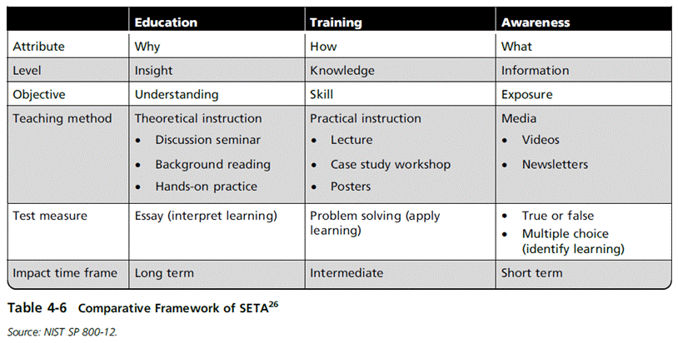
Principles of Information Security, Fifth Edition

Slide 38
Continuity Strategies
Incident response plans (IRPs); disaster recovery plans (DRPs); business continuity plans (BCPs)
Primary functions of above plans:
  IRP focuses on immediate response; if attack escalates or is disastrous, process changes to disaster recovery and BCP.
  DRP typically focuses on restoring systems after disasters occur; as such, it is closely associated with BCP.
  BCP occurs concurrently with DRP when damage is major or ongoing, requiring more than simple restoration of information and information resources.
Principles of Information Security, Fifth Edition
Notes:
Continuity Strategies
Incident response plans (IRPs); disaster recovery plans (DRPs); business continuity plans (BCPs)
Primary functions of above plans
IRP focuses on immediate response; if attack escalates or is disastrous, process changes to disaster recovery and BCP
DRP typically focuses on restoring systems after disasters occur; as such, is closely associated with BCP
BCP occurs concurrently with DRP when damage is major or ongoing, requiring more than simple restoration of information and information resources

Slide 39
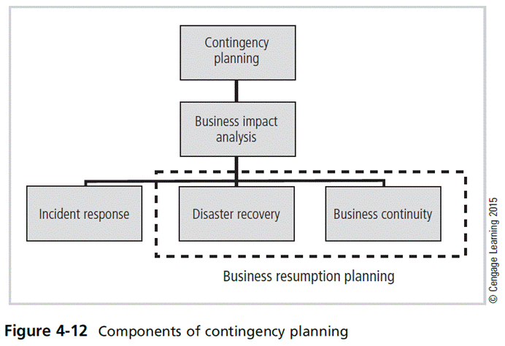
Principles of Information Security, Fifth Edition

Slide 40
Continuity Strategies (cont’d)
Before planning can actually begin, a team has to start the process.
Champion: high-level manager to support, promote, and endorse findings of the project
Project manager: leads project and ensures sound project planning process is used, a complete and useful project plan is developed, and project resources are prudently managed
Team members: should be managers, or their representatives, from various communities of interest: business, IT, and information security
Principles of Information Security, Fifth Edition
Notes:
Contingency Planning Team
Before any planning can begin, a team has to plan the effort and prepare the resulting documents
Champion - A high-level manager to support, promote, and endorse the findings of the project
Project Manager - Leads the project and makes sure a sound project planning process is used, a complete and useful project plan is developed, and project resources are prudently managed
Team Members - Should be the managers or their representatives from the various communities of interest: business, IT, and information security

Slide 41
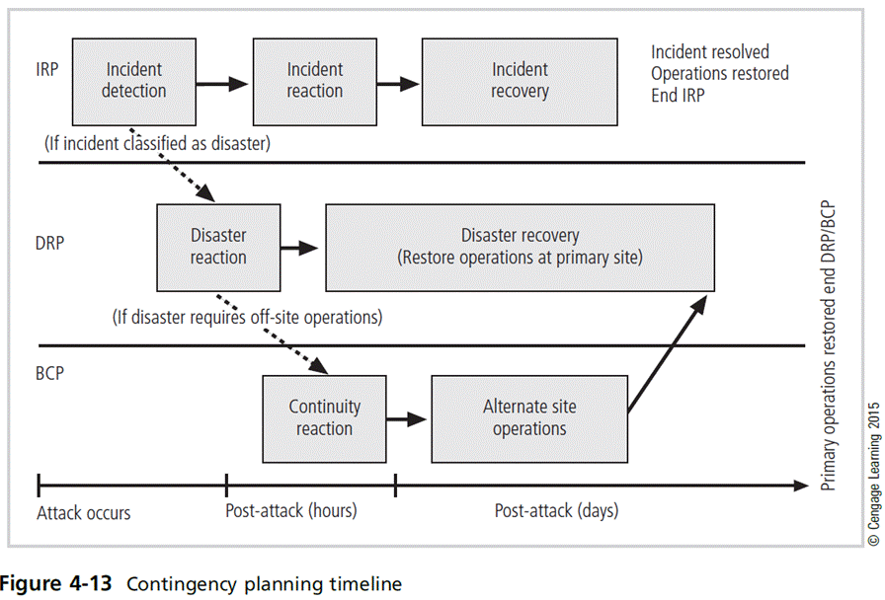
Principles of Information Security, Fifth Edition

Slide 42
Contingency Planning (CP) Process
Includes the following steps:
  Develop CP policy statement
  Conduct business impact analysis
  Identify preventive controls
  Create contingency strategies
  Develop contingency plan
  Ensure plan testing, training, and exercises
  Ensure plan maintenance
Principles of Information Security, Fifth Edition
Notes:
Contingency Planning Process
Includes following steps:
Develop CP policy statement
Conduct business impact analysis
Identify preventive controls
Create contingency strategies
Develop contingency plan
Ensure plan testing, training, and exercises
Ensure plan maintenance

Slide 43
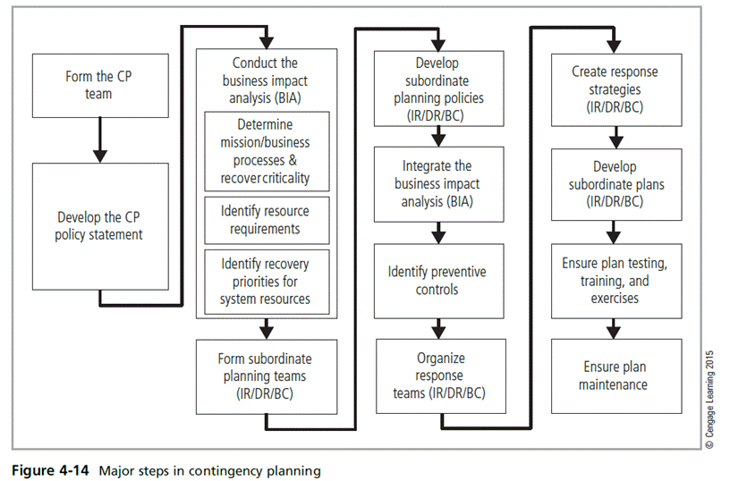
Principles of Information Security, Fifth Edition

Slide 44
CP Policy
Should contain the following sections:
  Introductory statement of philosophical perspective
  Statement of scope/purpose
  Call for periodic risk assessment/BIA
  Specification of CP’s major components
  Call for/guidance in the selection of recovery options
  Requirement to test the various plans regularly
  Identification of key regulations and standards
  Identification of key people responsible for CP operations
  Challenge to the organization members for support
  Administrative information
Principles of Information Security, Fifth Edition
Notes:
CP Policy
Should contain following sections:
Introductory statement of philosophical perspective
Statement of scope/purpose
Call for periodic risk assessment/BIA
Specification of CP’s major components
Call for/guidance in selection of recover options
Requirement to test various plans regularly
Identification of key regulations and standards
Identification of key people responsible for CP operations
Challenge to organization members for support
Administrative information

Slide 45
Business Impact Analysis (BIA)
Investigation and assessment of various adverse events that can affect organization
Assumes security controls have been bypassed, have failed, or have proven ineffective, and attack has succeeded
Organization should consider scope, plan, balance, knowledge of objectives, and follow-ups
Three stages:
  Determine mission/business processes and recovery criticality
  Identify recovery priorities for system resources
  Identify resource requirements
Principles of Information Security, Fifth Edition

Slide 46
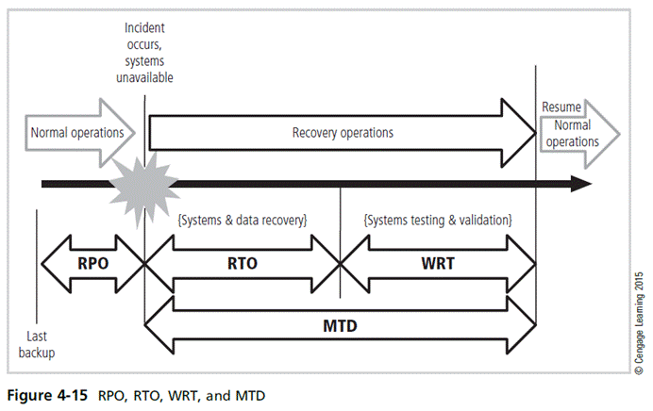
Principles of Information Security, Fifth Edition

Slide 47
Incident Response Planning
Incident response planning includes identification of, classification of, and response to an incident.
Attacks classified as incidents if they:
  Are directed against information assets
  Have a realistic chance of success
  Could threaten confidentiality, integrity, or availability of information resources
Incident response (IR) is more reactive than proactive, with the exception of planning that must occur to prepare IR teams to be ready to react to an incident.
Principles of Information Security, Fifth Edition
Notes:
Incident Response Planning
Incident response planning covers the identification of, classification of, and response to an incident.
The IRP is made up of activities that are to be performed when an incident has been identified.
An incident is an attack against an information asset that poses a clear threat to the confidentiality, integrity, or availability of information resources.
Attacks are only classified as incidents if they have the following characteristics:
Are directed against information assets
Have a realistic chance of success
Could threaten the confidentiality, integrity, or availability of information resources.
Incident response (IR) is the set of activities taken to plan for, detect, and correct the impact of an incident on information resources.
IR is more reactive than proactive, with the exception of the planning that must occur to prepare the IR teams to be ready to react to an incident.
Planning for an incident requires a detailed understanding of the scenarios developed for the BIA.

Slide 48
Incident Response Planning (cont’d)
Incident response policy identifies the following key components:
  Statement of management commitment
  Purpose/objectives of policy
  Scope of policy
  Definition of InfoSec incidents and related terms
  Organizational structure
  Prioritization or severity ratings of incidents
  Performance measures
  Reporting and contact forms
Principles of Information Security, Fifth Edition
Notes:
IR Planning
Incident response policy identifies following key components
Statement of management commitment
Purpose/objectives of policy
Scope of policy
Definition of InfoSec incidents and related terms
Organizational structure
Prioritization or severity ratings of incidents
Performance measures
Reporting and contact forms

Slide 49
Incident Response Planning (cont’d)
Incident Planning
  Predefined responses enable the organization to react quickly and effectively to the detected incident if:
    The organization has an IR team
    The organization can detect the incident
  IR team consists of individuals needed to handle systems as incident takes place.
Incident response plan
  Format and content
  Storage
  Testing
Principles of Information Security, Fifth Edition
Notes:
Incident Response Planning
Incident Planning
Predefined responses enable organization to react quickly and effectively to detected incident if:
Organization has IR team
Organization can detect incident
IR team consists of individuals needed to handle systems as incident takes place
Incident response plan
Format and content
Storage
Testing

Slide 50
Incident Response Planning (cont’d)
Incident detection
  Most common occurrence is complaint about technology support, often delivered to help desk.
  Careful training is needed to quickly identify and classify an incident.
  Once incident is properly identified, the organization can respond.
  Incident indicators vary.
Principles of Information Security, Fifth Edition
Notes:
Incident Response Planning
Incident detection
Most common occurrence is complaint about technology support, often delivered to help desk
Careful training needed to quickly identify and classify an incident
Once incident is properly identified, organization can respond
Incident indicators vary

Slide 51
Incident Response Planning (cont’d)
Incident reaction
  Consists of actions that guide the organization to stop incident, mitigate its impact, and provide information for recovery
  Actions that must occur quickly:
    Notification of key personnel
    Documentation of the incident
Incident containment strategies
  Containment of incident’s scope or impact as first priority; must then determine which information systems are affected
  Organization can stop incident and attempt to recover control through a number or strategies.
Principles of Information Security, Fifth Edition
Notes:
Incident Response Planning
Incident reaction
Consists of actions that guide organization to stop incident, mitigate its impact, and provide information for recovery
Actions that must occur quickly:
Notification of key personnel
Documentation of incident
Incident containment strategies
Containment of incident’s scope or impact first priority; must then determine which information systems affected
Organization can stop incident and attempt to recover control through a number or strategies

Slide 52
Incident Response Planning (cont’d)
Incident recovery
  Once incident has been contained and control of systems regained, the next stage is recovery.
  The first task is to identify human resources needed and launch them into action.
  Full extent of the damage must be assessed.
  Organization repairs vulnerabilities, addresses any shortcomings in safeguards, and restores data and services of the systems.
Principles of Information Security, Fifth Edition
Notes:
Incident Recovery
Once the incident has been contained and control of the systems regained, the next stage is recovery.
As with reaction to the incident, the first task is to identify the human resources needed for the recovery and launch them into action.
The full extent of the damage must be assessed.
The process of computer forensics entails determining how the incident occurred and what happened.
The organization repairs vulnerabilities, addresses any shortcomings in safeguards, and restores the data and services of the systems.

Slide 53
Incident Response Planning (cont’d)
Damage assessment
  Several sources of information on damage can be used, including system logs, intrusion detection logs, configuration logs and documents, documentation from incident response, and results of detailed assessment of systems and data storage.
  Computer evidence must be carefully collected, documented, and maintained to be usable in formal or informal proceedings.
  Individuals who assess damage need special training.
Principles of Information Security, Fifth Edition
Notes:
Damage Assessment
Damage assessment
Several sources of information on damage, including system logs; intrusion detection logs; configuration logs and documents; documentation from incident response; and results of detailed assessment of systems and data storage
Computer evidence must be carefully collected, documented, and maintained to be usable in formal or informal proceedings
Individuals who assess damage need special training

Slide 54
Incident Response Planning (cont’d)
Automated response
  New systems can respond to incident threat autonomously.
  Downsides of current automated response systems may outweigh benefits.
    Legal liabilities of a counterattack
    Ethical issues
Principles of Information Security, Fifth Edition
Notes:
Automated Response
While traditional systems were configured to detect incidences and then notify the human administrator, new systems can respond to the incident threat autonomously.
These systems, referred to as trap and trace, use a combination of resources to detect an intrusion and then trace incidents back to their sources.
Unfortunately, some less scrupulous administrators might even be tempted to back hack or hack into a hacker’s system to find out as much as possible about the hacker.
The problem is that the hacker may actually move into and out of a number of organizations’ systems, and by tracking the hacker, administrators may wander through other organizations’ systems.
The trap portion frequently involves the use of honey pots or honey nets.
Honey pots are computer servers configured to resemble production systems. If a hacker stumbles into the system, alarms are set off and the administrator is notified.
Honey nets consist of networks or subnets of systems that operate similarly.
Enticement is the process of attracting attention to a system by placing tantalizing bits of information in key locations.
Entrapment is the action of luring an individual into committing a crime to get a conviction.
Enticement is legal and ethical, while entrapment is not.

Slide 55
Disaster Recovery Planning
Disaster recovery planning (DRP) is preparation for and recovery from a disaster.
The contingency planning team must decide which actions constitute disasters and which constitute incidents.
When situations are classified as disasters, plans change as to how to respond; take action to secure most valuable assets to preserve value for the longer term.
DRP strives to reestablish operations at the primary site.
Principles of Information Security, Fifth Edition
Notes:
Disaster Recovery Planning
Disaster recovery planning (DRP) is planning the preparation for and recovery from a disaster
The contingency planning team must decide which actions constitute disasters and which constitute incidents
When situations classified as disasters, plans change as to how to respond; take action to secure most valuable assets to preserve value for the longer term
DRP strives to reestablish operations at the primary site

Slide 56
Business Continuity Planning
Prepares the organization to reestablish or relocate critical business operations during a disaster that affects operations at the primary site
If disaster has rendered the current location unusable, there must be a plan to allow business to continue functioning.
Development of BCP is somewhat simpler than IRP or DRP.
  Consists primarily of selecting a continuity strategy and integrating off-site data storage and recovery functions into this strategy
Principles of Information Security, Fifth Edition
Notes:
Business Continuity Planning
Prepares organization to reestablish or relocate critical business operations during a disaster that affects operations at the primary site
If disaster has rendered current location unusable, there must be a plan to allow business to continue functioning
Development of BCP is somewhat simpler than IRP or DRP
Consists primarily of selecting a continuity strategy and integrating off-site data storage and recovery functions into this strategy

Slide 57
Business Continuity Planning (cont’d)
Continuity strategies
  There are a number of strategies for planning for business continuity.
  Determining factor in selecting between options is usually cost.
  In general, there are three exclusive options: hot sites, warm sites, and cold sites.
  Three shared functions: time-share, service bureaus, and mutual agreements
Principles of Information Security, Fifth Edition
Notes:
Continuity Strategies
Continuity strategies
There are a number of strategies for planning for business continuity
Determining factor in selecting between options is usually cost
In general there are three exclusive options: hot sites, warm sites, and cold sites
Three shared functions: time-share, service bureaus, and mutual agreements

Slide 58
Business Continuity Planning (cont’d)
Off-site disaster data storage
  To get sites up and running quickly, an organization must have the ability to move data into new site’s systems.
  Options for getting operations up and running include:
    Electronic vaulting
    Remote journaling
    Database shadowing
Principles of Information Security, Fifth Edition
Notes:
Off-Site Disaster Data Storage
Off-Site disaster data storage
To get sites up and running quickly, an organization must have the ability to move data into new site’s systems
Options for getting operations up and running include:
Electronic vaulting
Remote journaling
Database shadowing

Slide 59
Crisis Management
Actions taken in response to an emergency to minimize injury/loss of life, preserve organization’s image/market share, and complement disaster recovery/business continuity processes
What may truly distinguish an incident from a disaster are the actions of the response teams.
Disaster recovery personnel must know their roles without any supporting documentation.
  Preparation
  Training
  Rehearsal
Principles of Information Security, Fifth Edition
Notes:
Crisis Management
Actions taken in response to an emergency to minimize injury/loss of life, preserve organization’s image/market share, and complement disaster recovery/business continuity processes
What may truly distinguish an incident from a disaster are the actions of the response teams
Disaster recovery personnel must know their roles without any supporting documentation
Preparation
Training
Rehearsal

Slide 60
Crisis Management (cont’d)
Crisis management team is responsible for managing the event from an enterprise perspective and covers:
  Supporting personnel and families during crisis
  Determining impact on normal business operations and, if necessary, making disaster declaration
  Keeping the public informed
  Communicating with major customers, suppliers, partners, regulatory agencies, industry organizations, the media, and other interested parties
Principles of Information Security, Fifth Edition
Notes:
Crisis Management
Crisis management team is responsible for managing event from an enterprise perspective and covers:
Supporting personnel and families during crisis
Determining impact on normal business operations and, if necessary, making disaster declaration
Keeping the public informed
Communicating with major customers, suppliers, partners, regulatory agencies, industry organizations, the media, and other interested parties

Slide 61
Crisis Management (cont’d)
Key areas of crisis management also include:
  Verifying personnel head count
  Checking alert roster
  Checking emergency information cards
Principles of Information Security, Fifth Edition
Notes:
Crisis Managment
Key areas of crisis management also include
Verifying personnel head count
Checking alert roster
Checking emergency information cards

Slide 62
The Consolidated Contingency Plan
Single document set approach combines all aspects of contingency policy and plan, incorporating IR, DR, and BC plans.
Often created and stored electronically, it should be easily accessible by employees in time of need.
  Small- and medium-sized organizations may also store hard copies of the document.
Principles of Information Security, Fifth Edition
Notes:
Consolidated Contingency Plan
Single document set approach combines all aspects of contingency policy and plan, incorporating IR, DR, and BC plans
Often created and stored electronically, should be easily accessible by employees in time of need
Small and medium-sized organizations may also store hard copies of document

Slide 63
Law Enforcement Involvement
When incident at hand constitutes a violation of law, the organization may determine involving law enforcement is necessary.
Questions:
  When should law enforcement get involved?
  What level of law enforcement agency should be involved (local, state, federal)?
  What happens when law enforcement agency is involved?
Some questions are best answered by the legal department.
Principles of Information Security, Fifth Edition
Notes:
Law Enforcement Involvement
There may come a time when it has been determined that the incident at hand exceeds the violation of policy and constitutes a violation of law.
The organization may determine that involving law enforcement is necessary.
There are several questions that must then be answered.
When should the organization get law enforcement involved?
What level of law enforcement agency should be involved: local, state, or federal?
What will happen when the law enforcement agency is involved?
Some of these questions are best answered by the organization’s legal department.

Slide 64
Benefits and Drawbacks of Law Enforcement Involvement
Involving law enforcement agencies has advantages:
  Agencies may be better equipped at processing evidence.
  Organization may be less effective in extracting necessary information to legally convict suspected criminal.
  Law enforcement agencies are prepared to handle any necessary warrants and subpoenas.
  Law enforcement is skilled at obtaining witness statements and other information collection.
Principles of Information Security, Fifth Edition
Notes:
Benefits of Law Enforcement Involvement
Involving law enforcement agencies has advantages:
Agencies may be better equipped at processing evidence
Organization may be less effective in extracting necessary information to legally convict suspected criminal
Law enforcement agencies are prepared to handle any necessary warrants and subpoenas
Law enforcement is skilled at obtaining witness statements and other information collection

Slide 65
Benefits and Drawbacks of Law Enforcement Involvement (cont’d)
Involving law enforcement agencies has disadvantages:
  Once a law enforcement agency takes over the case, the organization cannot control the chain of events.
  The organization may not hear about the case for weeks or months.
  Equipment vital to the organization’s business may be tagged as evidence.
  If the organization detects a criminal act, it is legally obligated to involve appropriate law enforcement officials.
Principles of Information Security, Fifth Edition
Notes:
Drawbacks to Law Enforcement Involvement
Involving law enforcement agencies has disadvantages:
Once a law enforcement agency takes over case, organization cannot control chain of events
Organization may not hear about case for weeks or months
Equipment vital to the organization’s business may be tagged as evidence
If organization detects a criminal act, it is legally obligated to involve appropriate law enforcement officials

Slide 66
Summary
Management has an essential role in the development, maintenance, and enforcement of information security policy, standards, practices, procedures, and guidelines.
Information security blueprint is planning the document that is the basis for design, selection, and implementation of all security policies, education and training programs, and technological controls.
Principles of Information Security, Fifth Edition

Slide 67
Summary (cont’d)
Information security education, training, and awareness (SETA) is a control measure that reduces accidental security breaches and increases organizational resistance to many other forms of attack.
Contingency planning (CP) is made up of three components: incident response planning (IRP), disaster recovery planning (DRP), and business continuity planning (BCP).
Principles of Information Security, Fifth Edition

